Slide 1
PITCH SEGMENT

Slide 2

Company Overview
Xyz company
Our vision is to become the leading global brand in the stuffed animal toys market by continuously innovating and expanding our product line to meet the evolving needs and preferences of our customers.
Niche: Teddy Bear segment
Launched in March 2012
Region : USA

Slide 3
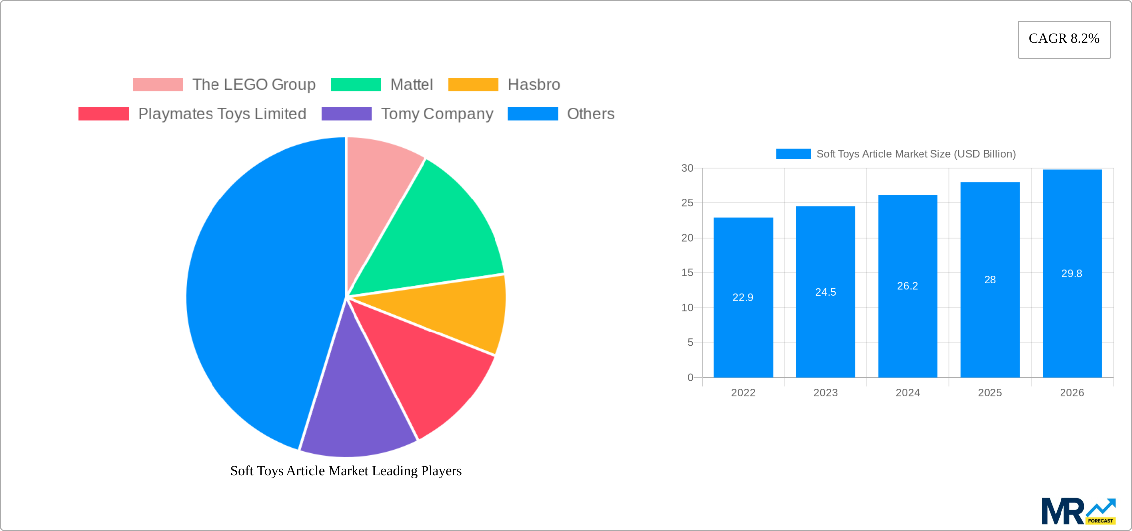
Market Research
Current status:
The Soft Toys Article Market size was valued at 22.9 USD Billion in 2023 and is projected to reach 29.8 USD Billion by 2032, exhibiting a CAGR of 8.2 % during the forecast period.

Slide 4
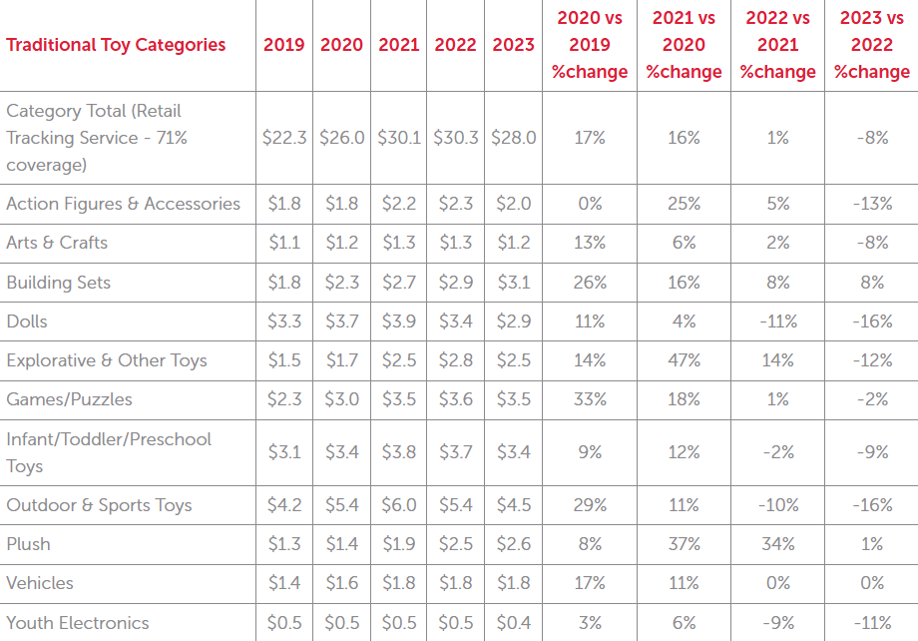
Annual Sales Data
Chart Source: Circana/Retail Tracking Service/US/Jan-Dec.2023

Slide 5
Growth Catalysts in Soft Toys Article Industry
Increasing Disposable Income
Growing Awareness of Developmental Benefits
Expanding Gifting Culture
Customization and Personalization Trends
Sustainability and Eco-Friendly Products
Technological Advancements:
Licensed and Character-Based Toys
Emotional and Therapeutic Value
Marketing and Brand Loyalty
Globalization and Cultural Influence
Innovative Product Designs

Slide 6
Supported Facts and Statistics

Slide 7
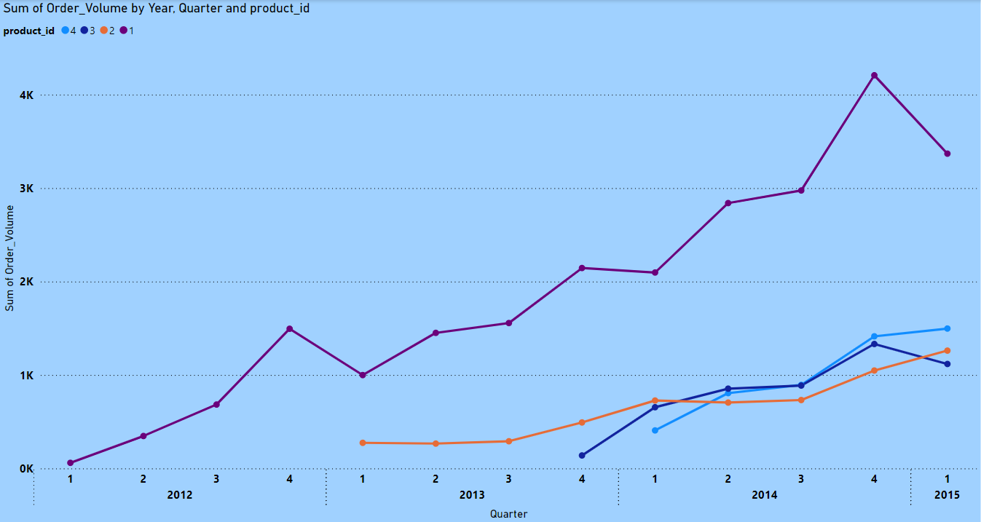
Order volume
There has been a consistent increase in order volume of each product, that shows the growth potential

Slide 8
Insights
1. Steady Growth in Flagship Product (Product 1)
Consistent Growth: From 60 orders in Q1 2012 to 3,369 in Q1 2015.
Quarterly Highlights:
2012: Grew each quarter, reaching 1,495 in Q4.
2013: Peaked at 2,145 in Q4.
2014: Substantial growth with 4,208 in Q4.
2015: Strong demand continues with 3,369 in Q1.
2. Introduction and Performance of New Products
Product 2:
Launched in Q1 2013, grew from 274 orders to 1,048 in Q4 2014.
Strong Q1 2015 performance with 1,261 orders.
Products 3 and 4:
Product 3: Launched in Q4 2013, grew from 139 orders to 1,332 by Q4 2014.
Product 4: Launched in Q1 2014, grew from 407 orders to 1,414 by Q4 2014.

Slide 9
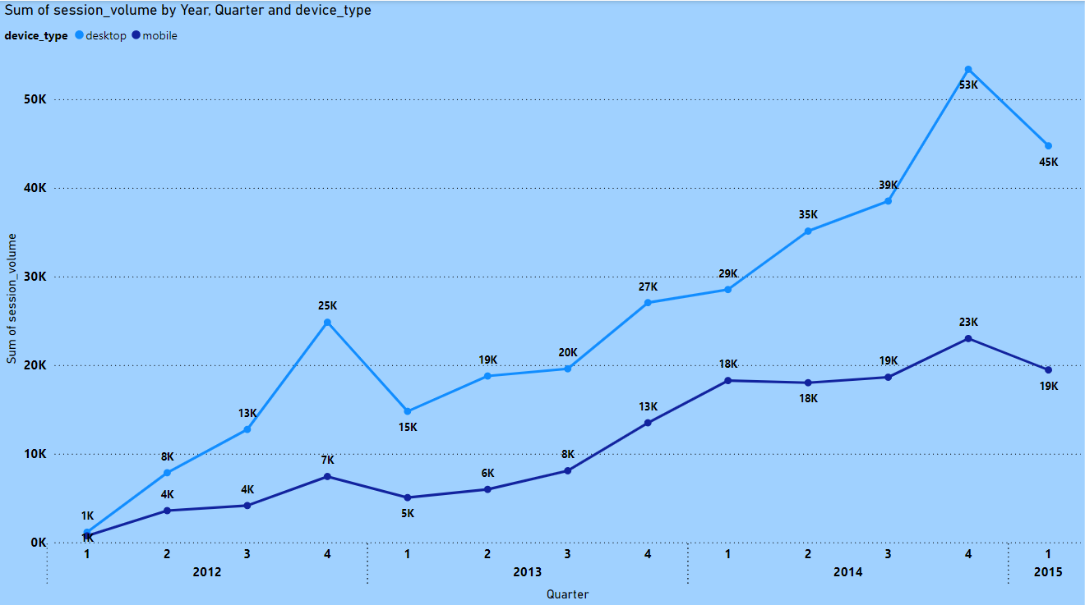
Traffic volume
There has been a consistent increase in traffic volume of each product, that shows the growth potential

Slide 10
Insights
1. Overall Growth in Session Volume
Steady Increase: Total session volume has consistently grown from Q1 2012 to Q1 2015.
Significant Growth: Desktop sessions increased from 1,145 in Q1 2012 to 44,742 in Q1 2015. Mobile sessions grew from 734 to 19,456 in the same period.
2. Device Type Trends
Desktop Dominance: Desktop sessions have consistently been higher, peaking at 53,375 in Q4 2014.
Rapid Mobile Growth: Mobile sessions showed a rapid increase, especially notable from 7,431 in Q4 2012 to 22,998 in Q4 2014.
3. Seasonal Peaks
Q4 Spikes: Both desktop and mobile sessions peak in Q4 of each year, indicating strong seasonal engagement.
Investment in Mobile Optimization: Given the rapid growth in mobile sessions, invest in optimizing the mobile user experience.

Slide 11
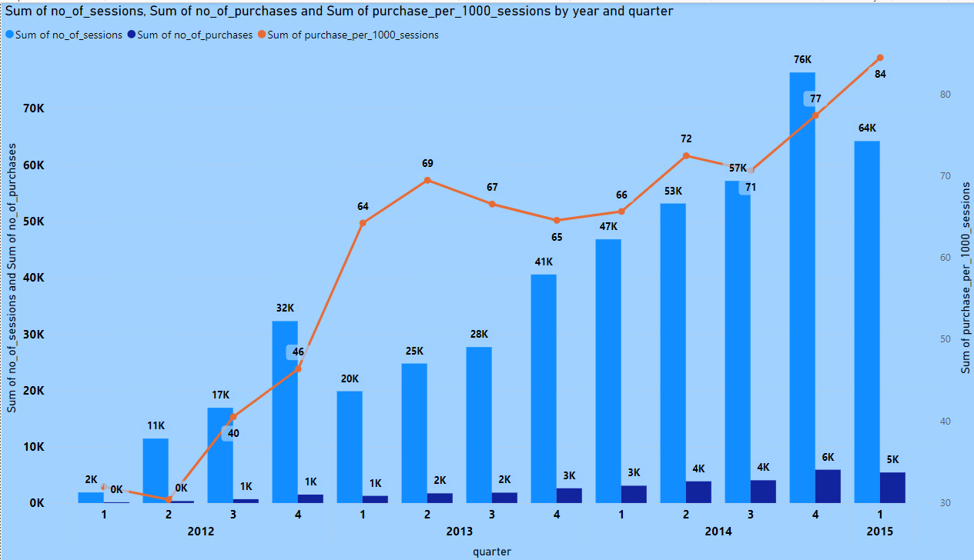
Session to order
Orange line indicates that there is an increase in conversion rate every month significantly, light blue and dark blue bars indicate the growth of website traffic and purchases respectively

Slide 12
Insights
1. Strong Growth in User Engagement
Rising Sessions: Total sessions have significantly increased from 1,879 in Q1 2012 to 64,198 in Q1 2015, indicating growing user interest and engagement.
2. Increasing Purchase Conversion Rates
Higher Purchases per Session: Purchases per 1,000 sessions rose from 31.93 in Q1 2012 to 84.43 in Q1 2015, showing improved conversion rates and effective marketing strategies.
3. Seasonal and Yearly Trends
Q4 Peaks: Sessions and purchases consistently peak in Q4, with the highest purchase rate of 77.36 per 1,000 sessions in Q4 2014, reflecting successful holiday campaigns.
Year-on-Year Improvement: The purchase rate improved steadily each year, demonstrating the effectiveness of customer acquisition and retention strategies.

Slide 13
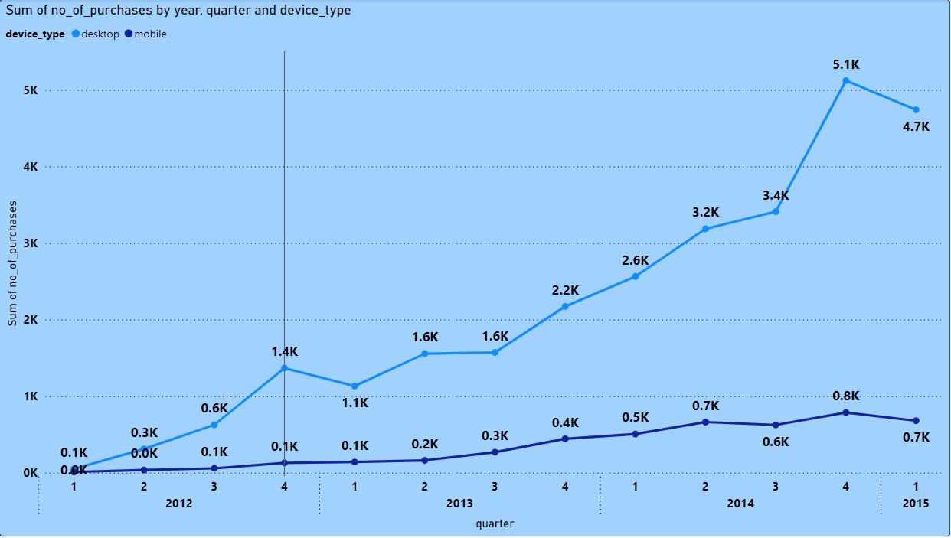
Session to purchase through device type
This shows that most people choose to purchase our products through desktop website so we are looking forward to increase our user experience of desktop website by taking people feedback

Slide 14
Insights
1. Significant Growth in Desktop Sessions and Conversions
Desktop Performance: Desktop sessions increased from 1,145 in Q1 2012 to 44,742 in Q1 2015, with purchases per 1,000 sessions peaking at 105.94 in Q1 2015. This indicates a strong desktop user base and high conversion efficiency.
2. Mobile Engagement and Improvement
Mobile Growth: Mobile sessions rose from 734 in Q1 2012 to 19,456 in Q1 2015, with purchases per 1,000 sessions improving from 13.62 to 34.95. While mobile conversions lag behind desktop, there's notable progress.
3. Quarterly Peaks and Trends
Q4 Performance: Consistent peak in Q4, with desktop purchases per 1,000 sessions reaching 95.96 in Q4 2014. Mobile purchases also peak in Q4, reflecting successful holiday campaigns.

Slide 15
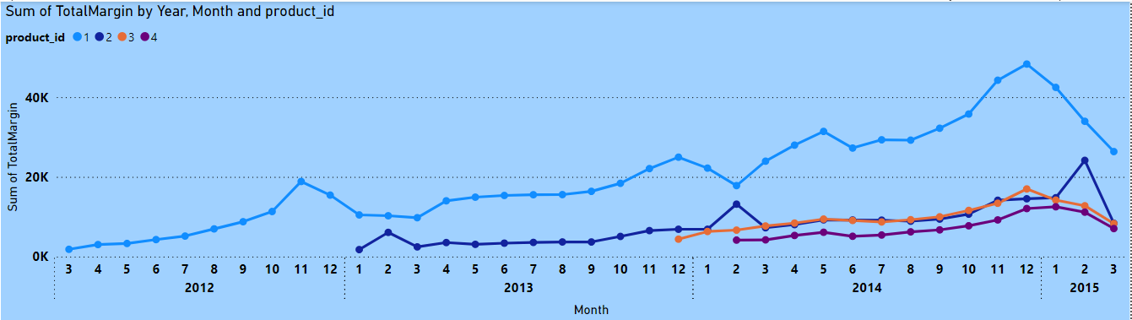
Sum of total margin by each product
This shows that since the inception of the first product out company has not seen any loss on any product additionally our profit margins are growing every month on all products period

Slide 16
Insights
1. Consistent Growth in Sales and Revenue
Steady Increase: Total sales, revenue, and margin have shown consistent growth from 2012 to 2015. For example, sales of Product 1 increased from 60 units in March 2012 to 1,392 units in January 2015.
Revenue Growth: Total revenue for Product 1 increased from $2,999 in March 2012 to $69,586 in January 2015, indicating strong demand and successful market penetration.
2. Introduction and Success of New Products
New Product Performance: Products 2, 3, and 4 introduced between 2013 and 2014 have contributed significantly to overall sales and revenue. Product 2, for example, saw sales of 644 units in February 2015, generating $38,633 in revenue.
3. Seasonal and Monthly Trends
Peak Periods: Sales and revenue peak during the last quarter of each year, particularly in November and December. For instance, Product 1 saw sales of 1,584 units in December 2014, generating $79,184 in revenue.

Slide 17
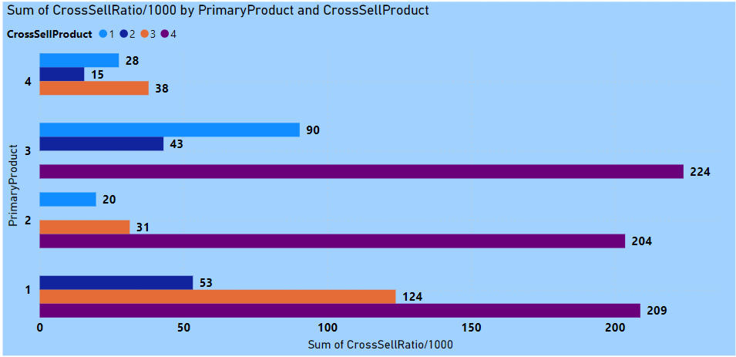
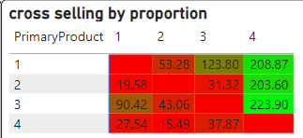
Cross selling performance
Through the graph we know that product 4 is the best cross selling product so we can come up with offers in order to promote cross selling, or develop our website algorithm to suggest product 4 with any other product

Slide 18
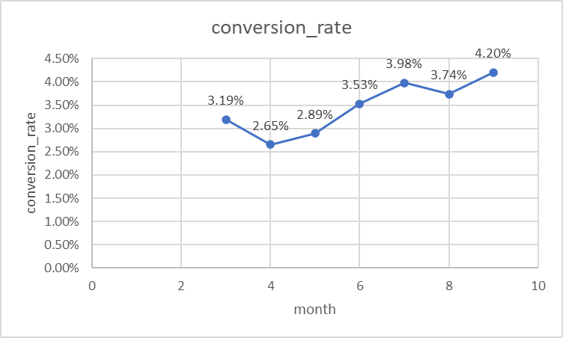
Website Performance
Session to Order Conversion rates,
past 8 months

Slide 19
Insights
Seasonal Trends:
The conversion rate has shown an upward trend from April (2.65%) to September (4.20%), with the highest rates observed in the months of July, August, and September. This could indicate a seasonal effect, where users are more likely to convert during the later months.
Steady Improvement:
The steady increase in conversion rates from April to September indicates an overall improvement in the effectiveness of marketing strategies or site optimizations over this period.
Exceptional Months:
June and July showed significant jumps in conversion rates (3.53% and 3.98% respectively) compared to previous months, indicating possibly effective campaigns or site changes during these months.
August saw a high number of total sessions (6097) with a strong conversion rate of 3.74%, indicating successful traffic generation and conversion strategies.

Slide 20
Recommendations
Analyze Successful Campaigns:
Review the marketing campaigns and site changes implemented in June, July, and August to identify what contributed to the increased conversion rates. Replicate these strategies in future campaigns.
Focus on High-Performing Periods:
Plan major promotions and marketing efforts around July, August, and September, as these months have shown the highest conversion rates.
Seasonal Promotions:
Develop seasonal promotions or campaigns for the months showing high conversion rates to capitalize on the increased propensity of users to convert during these times.

Slide 21
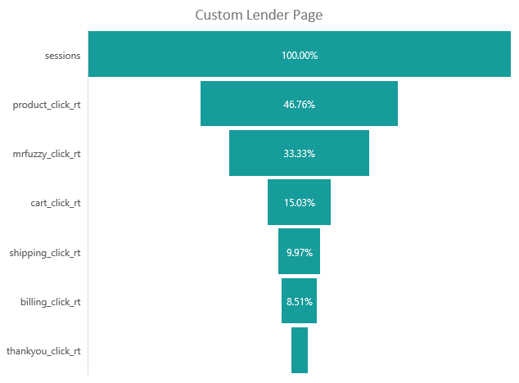
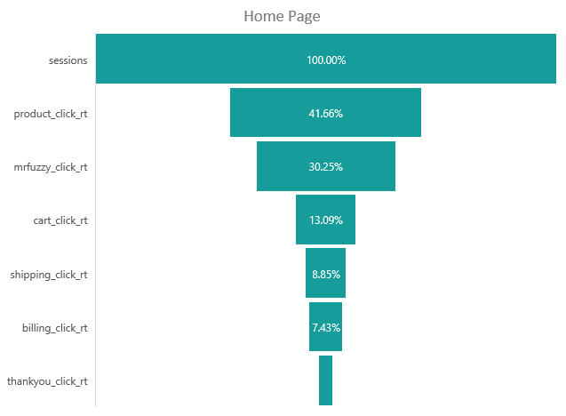
Impact after introducing lander tests
(2261 by count)
(2316 by count)
3.18% (72)
4.06% (94)

Slide 22
Analysis and Insights
Higher Engagement on Custom Lander:
Users who saw the custom lander had higher engagement at every step of the funnel compared to those who saw the homepage. This indicates that the custom lander is more effective in driving users through the purchase process.
Conversion Rates:
The custom lander led to a higher conversion rate to the thank you page (4.06%) compared to the homepage (3.18%). This suggests that users who land on the custom page are more likely to complete their purchases.
Funnel Drop-off:
Both pages saw a significant drop-off from the cart page to the shipping page. This is a critical point to address for optimization.
Recommendations
Adopt Custom Lander:
Optimize Cart to Shipping Transition:
Investigate and address potential friction points between the cart and shipping pages to reduce drop-off.
Further Testing:
Continue A/B testing with further variations of the custom lander to identify elements that can improve the conversion rates even further.
User Experience Analysis:
Conduct qualitative user experience research to understand why users might be dropping off at the cart stage and implement changes accordingly.
Given the higher engagement and conversion rates, the custom lander should be adopted as the primary landing page for the campaign.

Slide 23
Impact of Billing Test

Slide 24
Analysis and Impact:
Revenue Improvement:
During the test period, /billing-2 significantly outperformed the /billing page in terms of revenue per session ($31.34 vs. $22.83). This indicates that the new billing page was more effective in converting visitors into higher revenue orders.
Consistency Over Time:
The higher revenue per session for /billing-2 remained consistent even in the post-period ($31.25), while the original /billing page's revenue per session slightly declined ($22.36).
Session Volume:
The number of sessions for both billing pages increased in the post-period, indicating overall growth in site traffic or better funnel performance, but the /billing-2 page maintained its revenue efficiency despite higher traffic.
Recommendations:
Adopt /billing-2 as Default:
Given the consistent higher revenue per session, the /billing-2 page should be adopted as the default billing page.
Further Testing and Optimization:
Continue A/B testing with other potential improvements on the /billing-2 page to see if revenue per session can be further optimized.
Monitor Traffic Sources:
Ensure that the increase in sessions does not lead to a drop in revenue efficiency by monitoring traffic quality and optimizing sources.
Analyze User Behavior:
Conduct further analysis on user behavior on both billing pages to understand what specific elements of /billing-2 contribute to higher revenue.

Slide 25
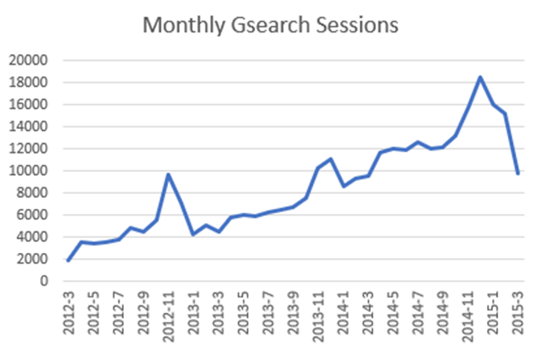
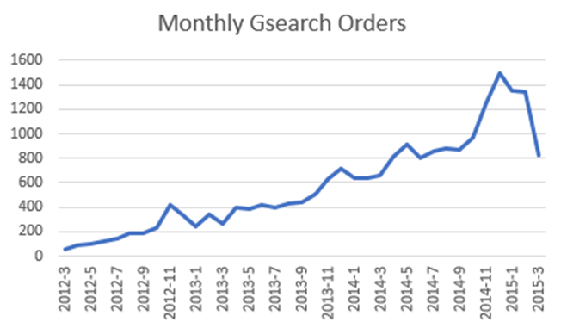
Impact of Gsearch and its Monthly Trend

Slide 26
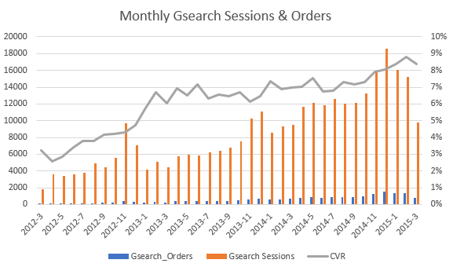
Conversion Rate from Gsearch

Slide 27
Insights
1. Overview of Gsearch as a Major Growth Driver:
Consistent Growth: Gsearch has shown robust and consistent growth in both sessions and orders over the analysis period, highlighting its critical role in driving our business forward.
2. Monthly Trends and Highlights:
2012: Establishing Growth
Q1 (Mar-Jun): Orders grew from 60 to 121, and sessions increased from 1,860 to 3,578.
Q2 (Jul-Dec): Orders surged to 333, with sessions peaking at 9,715 in November.
2013: Accelerated Growth
Q1 (Jan-Jun): Orders climbed from 243 to 421, sessions rose from 4,207 to 5,873.
Q2 (Jul-Dec): Orders reached 713 in December, sessions hit 11,060, highlighting holiday season impact.
2014: Sustained High Performance
Q1 (Jan-Jun): Orders increased from 634 to 802, sessions ranged from 8,607 to 11,859.
Q2 (Jul-Dec): Orders peaked at 1,500 in December, sessions soared to 18,577.
2015: Strong Start
Q1 (Jan-Mar): Orders maintained at high levels with 822 in March, sessions remained robust at 9,798.

Slide 28
Key Takeaways for Investors
Scalable Growth: The data showcases a strong and scalable growth trajectory for Gsearch, affirming its position as the biggest driver of our business.
Efficiency: The increasing conversion rate highlights the efficiency of our Gsearch campaigns, ensuring that traffic is effectively translated into sales.
Future Potential: With consistent growth in both sessions and orders, Gsearch demonstrates substantial potential for future expansion and revenue generation.

Slide 29
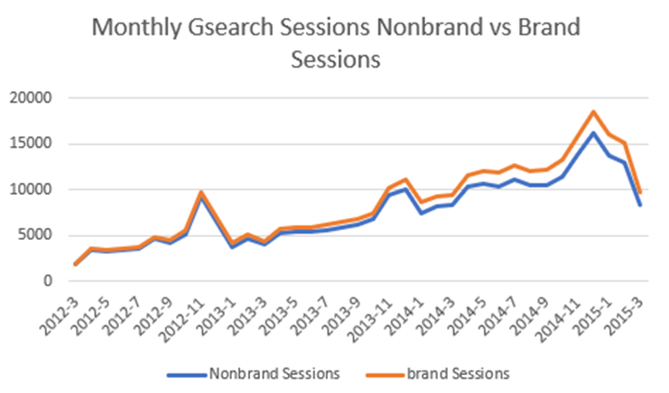
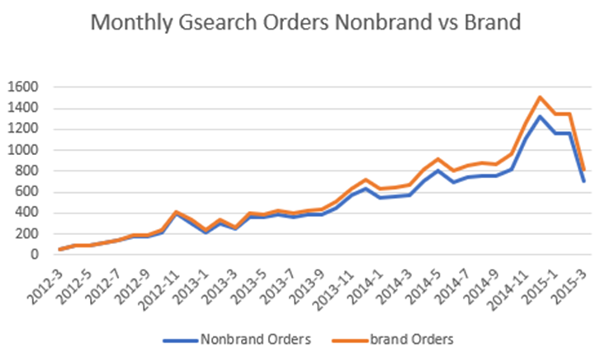
Contribution of Brand and Non-Brand in Gsearch

Slide 30
Insights
1. Overview of Gsearch Brand and Nonbrand Campaigns:
These trends might show initial dominance as the company established its presence, followed by a steady or slightly increasing pattern.
An upward trend in brand campaigns over time would indicate growing brand recognition and customer loyalty.
2. Monthly Trends and Highlights:
Initial Growth Phase (2012):
Nonbrand Campaigns: Steady increase in sessions and orders.
Brand Campaigns: Initial growth, establishing a presence.
Acceleration Phase (2013):
Nonbrand Campaigns: Significant growth, contributing to higher overall sessions and orders.
Brand Campaigns: Notable increase in sessions and orders, indicating improved brand recognition.
Maturation Phase (2014):
Nonbrand Campaigns: Continued strong growth, peaking towards the end of the year.
Brand Campaigns: Consistent growth with a noticeable impact on total sessions and orders.
Recent Trends (2015 Q1):
Nonbrand Campaigns: Sustained high performance, indicating robust marketing strategies.
Brand Campaigns: High and stable performance, showcasing successful brand loyalty efforts.

Slide 31
Key Takeaways for Investors:
Strong Growth in Both Campaigns: Both brand and nonbrand campaigns show significant growth in sessions and orders, indicating a well-rounded and effective marketing strategy.
High Conversion Rates: The conversion rates for both campaigns have improved substantially, demonstrating efficient traffic conversion into sales.
Brand Campaign Uplift: The brand campaign has shown remarkable growth, particularly in recent months, suggesting successful brand awareness and loyalty initiatives.
Recommendations:
Optimize Budget Allocation: Given the strong performance of both brand and nonbrand campaigns, optimize the budget to balance between the two, leveraging the high conversion rates.
Focus on Brand Campaigns: Continue to invest in brand campaigns to capitalize on the growing brand loyalty and recognition, which can drive long-term sustainable growth.
Track Seasonal Trends: Monitor seasonal trends and adjust bids and budget allocation to maximize returns during peak periods.

Slide 32
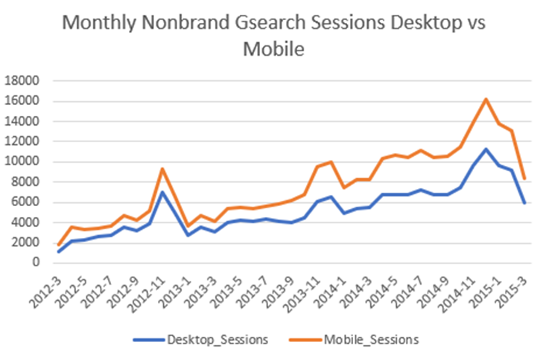
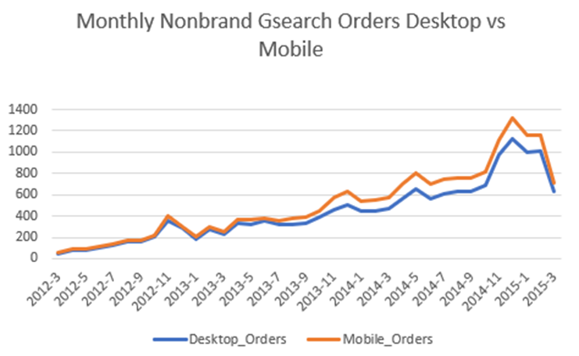
Distribution of Non-Brand Session among Various Devices
This reveals how different devices contribute to sessions and orders. For example, mobile might show a higher number of sessions but a lower conversion rate compared to desktop.

Slide 33
Insights
Desktop Devices:
Strong Growth: Desktop sessions and orders grew substantially, with conversion rates improving from 4.43% to 10.58%.
Consistent Performance: Steady increase in both sessions and orders, highlighting desktop as a reliable and high-performing channel.
Optimization Opportunity: With high conversion rates, focusing marketing spend on desktop users could yield better ROI.
Mobile Devices:
Moderate Growth: Mobile sessions and orders also increased, but conversion rates remain lower, improving from 1.38% to 3.38%.
Usability Concerns: The lower conversion rate suggests potential issues with mobile user experience, such as non-responsive design or slow load times.
Potential for Improvement: Enhancing mobile site performance could capture more mobile traffic and increase conversions.

Slide 34
Key Takeaways for Investors:
Desktop Dominance: Mobile might show a higher number of sessions but a lower conversion rate compared to desktop. Desktop devices consistently drive the majority of orders.
Mobile Growth: Although mobile sessions have increased, the conversion rates remain lower, indicating potential usability issues or display problems on mobile devices.
Seasonal Impact: Noticeable peaks in sessions and orders during the holiday seasons, especially on desktop devices, highlighting the importance of seasonal marketing efforts.
Recommendations:
Optimize Marketing Spend: Focus on desktop campaigns due to their higher conversion rates, but continue to improve mobile site usability and performance.
Improve Mobile Experience: Investigate and resolve potential usability issues on mobile devices to increase conversion rates.
Leverage Seasonal Trends: Plan and execute targeted campaigns during peak seasons to maximize returns, particularly on desktop devices.

Slide 35
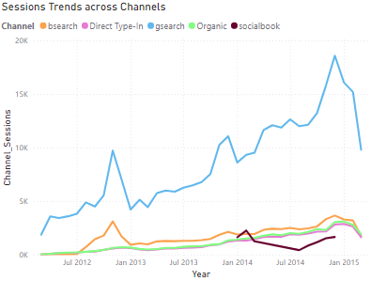
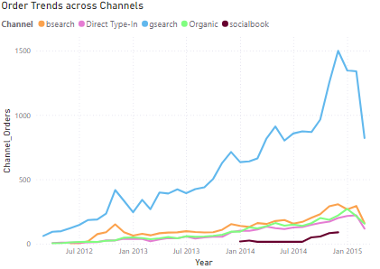
Traffic from Various Channels / Sources

Slide 36
Insights
Gsearch:
Dominant Traffic Source: Gsearch consistently remained the primary traffic source but showed a decreasing trend from 99% to 65%.
Order Contribution: Despite the decline in session percentage, Gsearch maintained a strong contribution to orders, dropping from 100% to 67% by March 2015.
Overall Performance: Gsearch sessions and orders decreased over time, indicating a potential shift in user behavior or changes in search engine algorithms.
Bsearch:
Emerging Channel: Bsearch sessions increased notably from mid-2012, growing to 11% of sessions by March 2015.
Order Growth: Bsearch orders followed a similar trend, increasing from negligible numbers to 9% by March 2015.
Socialbook:
New Contributor: Socialbook began contributing to traffic in 2014, with sessions peaking at 5% in December 2014.
Order Impact: Socialbook orders showed a growing trend, reaching 4% by December 2014.

Slide 37
Insights
Direct Type-in:
Stable Source: Direct type-in sessions and orders showed a slight but consistent increase, indicating steady direct engagement with the website.
Reliable Orders: Orders from direct type-ins remained relatively stable, contributing consistently to the overall order volume.
Organic Traffic:
Steady Growth: Organic sessions and orders showed steady growth, highlighting the importance of SEO efforts.
Significant Contribution: By March 2015, organic traffic accounted for 13% of sessions and 11% of orders, demonstrating its growing importance.

Slide 38
Key Takeaways for Investors:
Gsearch Dominance:
Gsearch has been the primary traffic source but its share is decreasing.
Despite the decline, Gsearch remains a strong contributor to orders.
Emerging Channels:
Bsearch and organic channels are growing, showing potential for future traffic and order growth.
Socialbook has started contributing to traffic and orders, indicating new opportunities in social media marketing.
Consistent Performance:
Direct type-in traffic and orders have shown steady performance, suggesting strong brand recognition and customer loyalty.
Recommendations:
Diversify Traffic Sources:
Continue investing in Gsearch but also increase focus on Bsearch and organic channels to balance traffic sources.
Explore new opportunities in social media marketing through platforms like Socialbook.
Optimize Marketing Spend:
Allocate marketing budgets strategically across Gsearch, Bsearch, and organic channels based on performance metrics.
Invest in SEO to further boost organic traffic and improve search engine rankings.

Slide 39
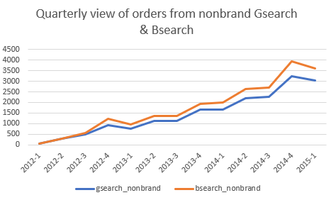
Gsearch Nonbrand & Bsearch Nonbrand
Gsearch Nonbrand:​
Growth Trend: Orders increased significantly from 60 in Q1 2012 to 3025 in Q1 2015.​
Peak Performance: Notable growth in 2014 with a substantial peak in Q4 2014 at 3248 orders.​
Bsearch Nonbrand:​
Initial Growth: Orders started from 0 in Q1 2012 to 581 in Q1 2015.​
Steady Increase: Consistent growth over the quarters, with notable increase in Q4 2014 reaching 683 orders.​​

Slide 40
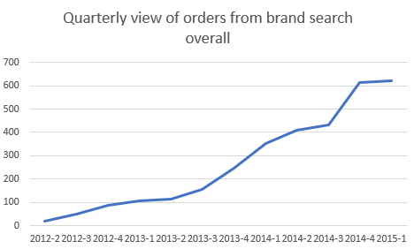
Insights
2. Brand Search Overall
Steady Rise: Orders grew from 20 in Q2 2012 to 622 in Q1 2015.
Strong Growth: Significant increase in Q4 2014, reaching 615 orders, indicating heightened brand recognition and search interest.

Slide 41
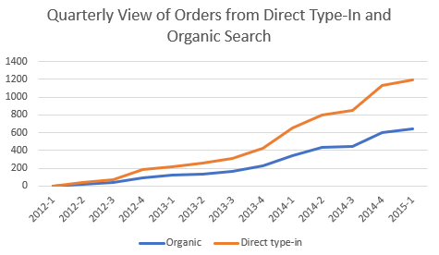
Insights
3. Organic Search & Direct Type-In
Organic Search:
Consistent Growth: Orders grew from 0 in Q1 2012 to 640 in Q1 2015.
Key Increase: Sharp rise in Q4 2014 to 605 orders, reflecting successful SEO efforts and increased organic reach.
Direct Type-In:
Steady Improvement: Orders increased from 0 in Q1 2012 to 552 in Q1 2015.
Strong Quarter: Significant growth in Q4 2014 with 532 orders, indicating strong brand loyalty and direct engagement.

Slide 42
Key Takeaways for Investors:
Gsearch Nonbrand has shown robust growth, particularly in 2014, highlighting its crucial role in driving orders. However, the growth in Bsearch Nonbrand suggests emerging opportunities in this channel.
Brand Search Overall has steadily increased, underscoring the success of brand-building strategies.
Organic Search and Direct Type-In channels have consistently grown, reflecting improved SEO efforts and strong brand loyalty.
Recommendations:
Leverage Gsearch Nonbrand Growth: Continue investing in Gsearch nonbrand, while exploring optimization strategies to maintain high performance.
Expand Bsearch Efforts: Increase focus on Bsearch nonbrand to capitalize on its growing contribution and explore additional marketing opportunities.
Enhance SEO and Direct Engagement: Strengthen SEO strategies to further boost organic search performance.
Invest in direct engagement initiatives to enhance brand loyalty and increase direct type-in orders.
Monitor Brand Search Trends: Maintain and enhance brand recognition efforts to sustain growth in brand search orders.

Slide 43
Conclusion

Slide 44
What We Have Achieved and Are Good At​
High Performance of Nonbrand Campaigns
Achievement: Exceptional performance of nonbrand campaigns on gsearch.
Strength: Effective keyword targeting and ad placement.
Seasonal Peaks
Achievement: Significant increase in sessions and orders during November and December.
Strength: Successful seasonal marketing strategies and ability to handle increased demand.
Organic Traffic
Achievement: High levels of organic traffic, particularly from gsearch.
Strength: Strong SEO practices and robust organic search presence.
Direct Traffic
Achievement: Robust direct traffic, indicating strong brand recognition and customer loyalty.
Strength: Effective brand awareness and customer satisfaction strategies.

Slide 45
What We Have Achieved and Are Good At​
Sustained Traffic Growth​
Achievement: Overall traffic increasing year over year.​
Strength: Successful marketing and user acquisition strategies.​
High-Performing Products​
Achievement: Popular products driving significant orders (e.g., The Original Mr. Fuzzy and The Forever Love Bear).​
Strength: Market favorite products.​
Conversion Rate​
Achievement: Reasonably good conversion rates, especially during peak seasons.​
Strength: Effective funnel optimization and checkout processes.​

Slide 46
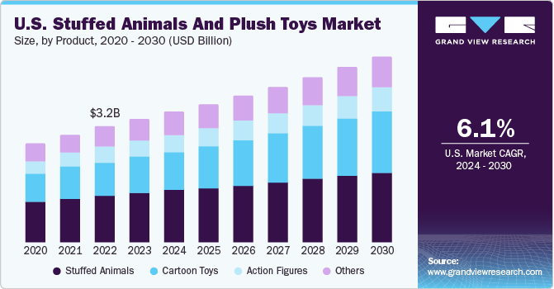
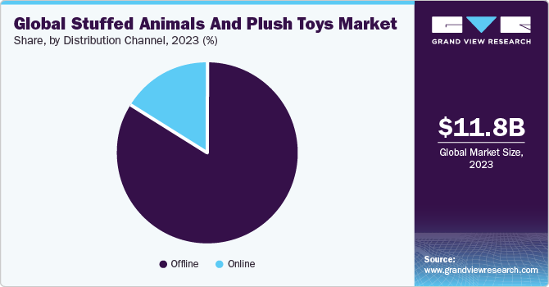
POTENTIAL SCOPE/OPPORTUNITY
Market Growth and Trends
Rising Demand for Plush Toys:
The plush toy market has seen consistent growth over the last few years.
E-commerce Boom:
The shift towards online shopping has accelerated, and plush toys are a category that benefits from this trend. Convenience, a wide selection, and easy personalization options make e-commerce an ideal platform for selling plush toys.

Slide 47
POTENTIAL SCOPE /OPPORTUNITY
Product Customization
Consumers increasingly value personalized products. Offering customization options—like choosing colors, adding names, or creating custom designs—can significantly boost customer engagement and loyalty
Geographic Expansion
There are many regions where the demand for plush toys is growing, but the market is still underpenetrated. Expanding into these markets can drive significant revenue growth.
AI and Personalization:
Utilize AI to offer personalized shopping experiences, such as recommending products based on browsing history or allowing customers to design their own plush toys online.

Slide 48
FUND UTILIZATION
Funds will be utilized in
Marketing and Customer Acquisition
Expanding Marketing Efforts:
To capture a larger market share, we need to increase your marketing budget. This includes digital marketing campaigns, social media ads, influencer partnerships, and SEO efforts to drive more traffic to our e-commerce platform.
Brand Building:
Building a strong brand requires investment in creative campaigns, public relations, and content creation to establish our brand as a leader in the plush toy market.
Technology and Platform Development
E-Commerce Platform Enhancement:
Funds are needed to improve the user experience on your website, integrate advanced features (like AI-driven recommendations), and ensure the platform can handle increased traffic.
Mobile App Development:
Creating a dedicated mobile app can enhance customer engagement and retention, offering a more personalized shopping experience.

Slide 49
FUND UTILIZATION
Expanding Product Line
To cater to a broader audience or capitalize on trends, we may need to invest in developing new plush toy designs, introducing customizable options, or launching limited-edition products.
Market Expansion
Expanding into new geographic markets (both domestic and international) requires capital for market research, localization of products, marketing in new regions, and establishing distribution channels.

Slide 50
What Can We Achieve
Enhanced Customer Retention
Potential: Increase repeat customers through targeted retention strategies.
Goal: Develop loyalty programs and personalized marketing.
Improved Mobile Optimization
Potential: Increase mobile conversion rates.
Goal: Enhance the mobile shopping experience.
Data-Driven Decision Making
Potential: Leverage historical data for strategic planning.
Goal: Use data insights for informed decisions on inventory, marketing, and customer engagement.
Expanded Traffic Source Diversification
Potential: Reduce dependency on a single channel.
Goal: Ensure a steady flow of visitors from various sources.

Slide 51
Recommendations for Achieving These Goals
Customer Retention
Action: Develop and implement loyalty programs.
Action: Use personalized marketing campaigns to re-engage past customers.
Action: Create targeted email campaigns based on customer purchase history.
Mobile Optimization
Action: Improve website speed and usability on mobile devices.
Action: Ensure seamless mobile checkout processes.
Action: Optimize mobile ads and promotions.
Data-Driven Decision Making
Action: Invest in advanced analytics tools.
Action: Train staff on data analysis and interpretation.
Action: Use predictive analytics for inventory management and marketing strategies.
Traffic Source Diversification
Action: Increase investment in underutilized channels (e.g., social media, affiliate marketing).
Action: Experiment with new advertising platforms.
Action: Optimize current campaigns for better performance.

Slide 52
Area of Improvements
Enhanced Data Utilization for Targeted Marketing:
Expand Product Range:
Optimize Supply Chain Management:
Improve Online User Experience:
Strengthen Customer Service:
Increase Market Penetration:
Enhance Brand Identity and Loyalty Programs:
Focus on Sustainability:
Utilize Customer Feedback:
Monitor and Reduce Bounce Rates:

Slide 53
Future Scope and Opportunities
Expansion into New Markets
Opportunity: Explore international markets for potential growth.
Strategy: Conduct market research and adapt marketing strategies for new regions.
Product Line Expansion
Opportunity: Introduce new products based on customer feedback and market trends.
Strategy: Analyze sales data to identify popular product categories and gaps in the market.
Enhanced Personalization
Opportunity: Use AI and machine learning to personalize customer experiences.
Strategy: Implement recommendation engines and personalized marketing messages.
Sustainability Initiatives
Opportunity: Appeal to environmentally conscious consumers by adopting sustainable practices.
Strategy: Highlight eco-friendly products and sustainable business practices in marketing campaigns.
Partnerships and Collaborations
Opportunity: Partner with other brands or influencers to reach new audiences.
Strategy: Identify potential partners with aligned values and customer bases.
Technological Advancements
Opportunity: Stay ahead by adopting new technologies in e-commerce and logistics.
Strategy: Invest in technology that enhances the shopping experience and streamlines operations.

Slide 54
THANK YOU

